Slide 1
(City Name)
IT Steering Committee/
Data Governance Committee Meeting

Slide 2
Agenda
Introductions
Welcome from Chair
Defining Open Data
Open Data in ...
Committee Goals
Next Steps

Slide 3
Defining Open Data

Slide 4
Open Data is...
Public | Published datasets live in the public domain.
Machine readable | Datasets are available in formats that computers can understand.
Fresh | Datasets contain current information to encourage maximum use.
Accessible | Datasets are accessible to the broadest range of users to use for varying purposes.
Automated | When datasets are created or updated, they are automatically uploaded to relevant systems.

Slide 5
Benefits of Opening Data
Saving time
Quicker solutions
Increased trust
New opportunities
Smarter decisions

Slide 6
Open Data for residents
Answer their own questions
Always have the latest information
Get information in a variety of formats
Empower neighborhood groups to improve their neighborhoods with a data driven approach
Ex. Which corner of our neighborhood has the most property violations?

Slide 7
Open data for business
Allow companies to make better decisions
Ex. Where should I park my food truck? Which sidewalk has the most pedestrian traffic at 11:30AM?
Even the playing field for information access
Zoning, demographic information, etc.

Slide 8

Public Information Requests
Open data proactively releases data online in accessible formats, reducing the need for public information requests
Chicago reduced information requests by 50%

Slide 9

Inter-departmental Collaboration
Open data makes it easier for departments to use each other’s data
In Maryland, the Department of Juvenile Services and the Department of Public Safety and Correctional Services shared data to identify overlap in populations they serve to make their jobs easier

Slide 10

Public Engagement
Open data helps employees engage with the public
Philadelphia asked the public for input on dataset release, and received many comments on value and potential use cases
Notes:
https://trello.com/b/iUUy84lK/deprecated-city-of-philadelphia-open-data-pipeline

Slide 11
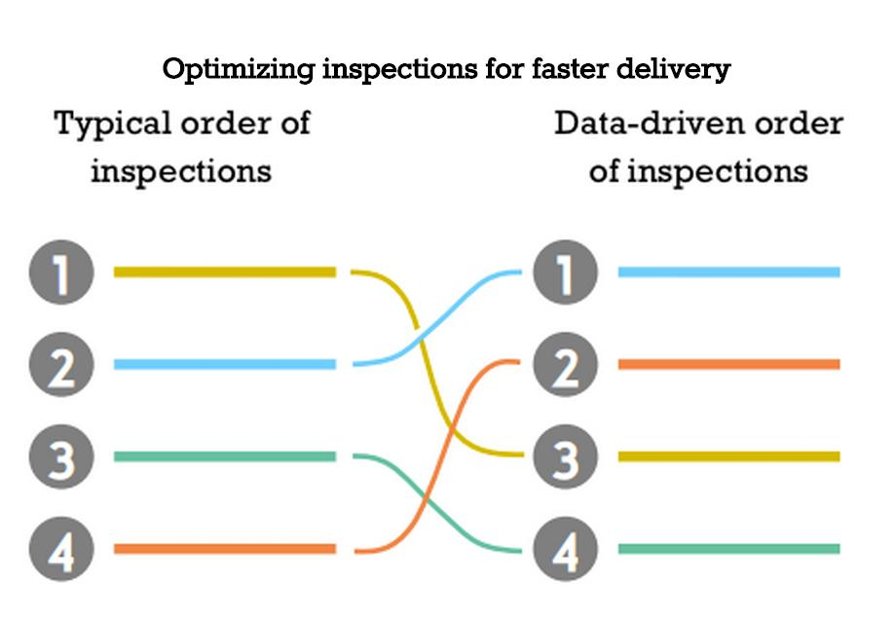
Optimized Workflow
Chicago used a forecasting model to predict critical violations
Discovered critical violations 7 days earlier than normal using 311 data
Notes:
http://chicago.github.io/food-inspections-evaluation/

Slide 12
Discussion Point
How can open data help you in your day to day work? What problems can you solve with open data? What questions can you answer?
It’s OK if you haven’t thought about this question before. Feel free to brainstorm in pairs or small groups!

Slide 13
Open Data in (City)

Slide 14
(City) is becoming a data driven city!
Connected with the What Works Cities network, comprised of Bloomberg Philanthropies, The Center for Government Excellence (GovEx) at Johns Hopkins University, and Sunlight Foundation
Building on existing performance and analytics practices
Linking performance to open data

Slide 15
Who is on board?
Use this slide to list the players who use open data in (City)
Examples:
Mayor and City Manager: Love transparency!
Departments: Need to access and use each other’s data
City Council: Engages with residents

Slide 16
Progress so far
Use this slide to indicate the progress (City) has made in open data so far
Examples:
Open Data Portal
Open Data Policy
Meet-Ups and Hackathons
Applications

Slide 17
Discussion Point
List any issues you have with accessing or sharing data
Examples:

Slide 18
Discussion Point
List any issues you have with accessing or sharing data
Examples:
“It takes too long to get data”
“Data is not machine-readable”
“Sometimes I need data from other departments”

Slide 19
Expansion plans
This issue is really complex.
So we decided to form this group as a way to develop “data people” in each department, and to create a forum for data conversations
The data governance committee is how we will move (City) forward with open data

Slide 20
IT Steering Committee/
Data Governance Committee

Slide 21
IT Steering Committee
/Data Governance Committee
Mayor/City Manager
Chair/Open Data Coordinator
Department Representative
Department Representative
Department Representative
Department Representative
IT Representative
Community Representative

Slide 22
It’s ok if you aren’t a data geek!
Don’t panic!
We all have varying degrees of data skills
We have access to good training material
The What Works Cities network is available to support us as well
We need people with diverse skillsets if we are going to
succeed!
Everything we are going to do can be broken down into
small, workable problems.

Slide 23
Discussion Point
What would you like to help this committee achieve?
Consider:
What are the goals of (City) open data initiative?
What are your favorite examples of the public using open data?
Who are the external stakeholders in (CIty) that can benefit from open data, and from information about our initiatives? What about internal stakeholders?
How can we provide regular updates on Open Data to the public? What messages would we like to share with them? What are they most receptive to?
What venues are best to connect with stakeholders--website, social media, event, in person meetings, etc.?
What’s the best way to determine stakeholder interest in the datasets once the inventory is posted? How can we include public feedback into the inventory process?
Which external partners (such as the CFA brigade) can we work with to reach a broader audience?
How can we encourage the public to use the data?
What are some upcoming milestones in the open data work that we can leverage for communications opportunities?

Slide 24
Discussion Point
What would you like to help this committee achieve?
Sample Data Governance Committee Goals:
Give as many people access to user friendly data as possible;
Establish a city-wide, cross-cutting data conversation;
Update residents, the Mayor, City Manager, and City Council on issues related to open data;
Invite and encourage departments to use (City’s) open data portal, providing trainings and demos for staff;
Establish a plan to liberate and maintain data.

Slide 25
Discussion Point
What would you like to help this committee achieve?
(City’s) Data Governance Committee Goals:
.

Slide 26
Next Steps
Review follow up notes and materials (via email)
Next Meeting:

